Slide 1
Laha: A Framework for adaptive optimization of distributed sensor frameworks
Anthony christe
24 February 2020

Slide 2
Distributed sensor networks
Convert physical phenomena into actionable insights
Dynamic
Heterogenous
Explosion of internet connected sensors
Increased bandwidth, storage, and computational requirements
Incomplete or incorrect data
Lots of primitive data, few insights

Slide 3
Laha: addressing DSN issues
Laha is an abstract distributed sensor framework that
Transforms primitive sensor data into actionable insights
Management of sensor data storage, retention, and analysis
Scales with minimal system degradation
Is general enough to apply to multiple DSN domains
Works with heterogenous and dynamic sensors
Provides predictive analytics
Provides self-optimization capabilities

Slide 4
Laha: A Framework for addressing DSN issues
These capabilities were evaluated and tested in the following ways:
Design of two Laha-compatible DSNs
Deployment of two Laha-compatible DSNs
Validation of data collected by deployments
Evaluation of major goals of Laha
Results showing the effectiveness of Laha through the results and evaluation of the Laha-compatible DSNs

Slide 5
Major claims of the laha framework
General and useful framework for multiple DSN domains
Convert primitive sensor data into actionable insights
Tiered management of Big Data
Tertiary goals and claims. Optimization of:
Triggering
Detection/Classification
Predictive analytics
Sensing field topology

Slide 6
Contribution #1: Laha design
Novel abstract distributed sensor framework
Converting primitive data into actionable insights
Sensor data management
Self-optimization capabilities

Slide 7
Contribution #2: Laha Evaluation
Deployment of two Laha-compatible DSNs
Validated data collection
Several experiments that test Laha’s major claims

Slide 8
Contribution #3: Laha-compliant reference implementations
OpenPowerQuality (OPQ)
Distributed power quality (PQ) detection and analysis
Lokahi
Distributed infrasound detection and analysis

Slide 9
Contribution #4: Implications for modern DSNs
A set of implications for modern DSNs through the evaluation of Laha
Confirmation or denial of Laha’s benefits in relation to DSNs
Other domains that Laha is useful or not useful for

Slide 10
Related work

Slide 11
Design of OPQ
OPQ consists of multiple-distributed services
Makai/Napali
Mauka
Health
View
MongoDB

Slide 12
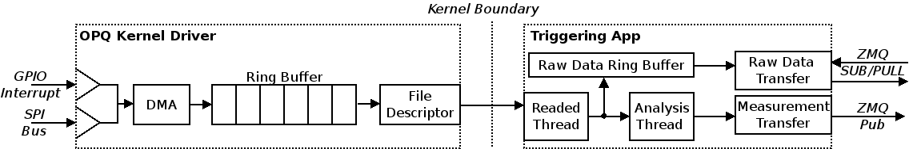
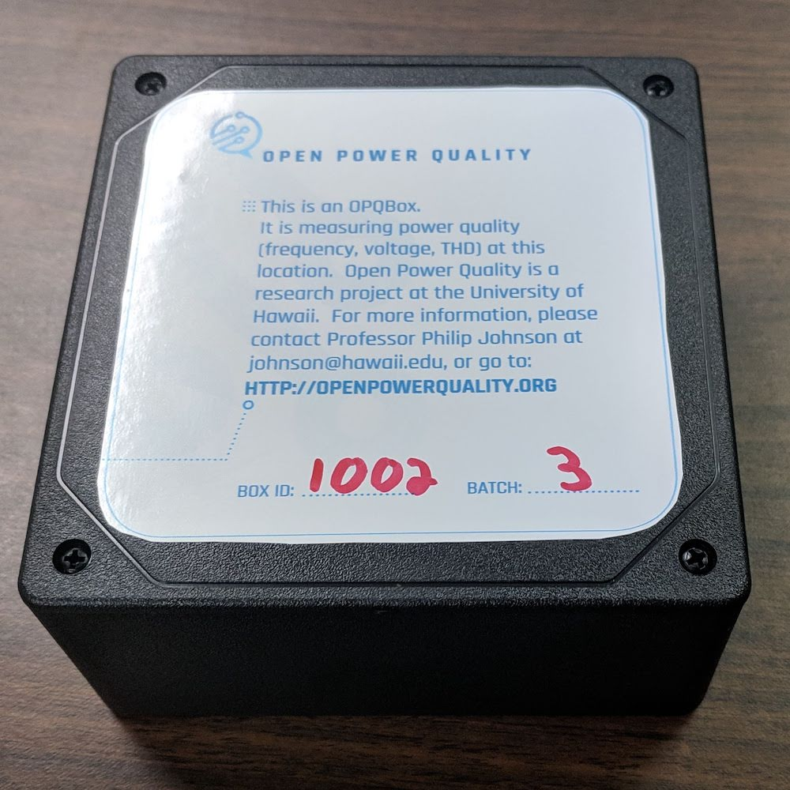
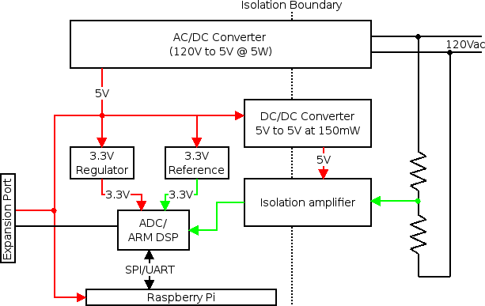
OPQ: Box

Slide 13
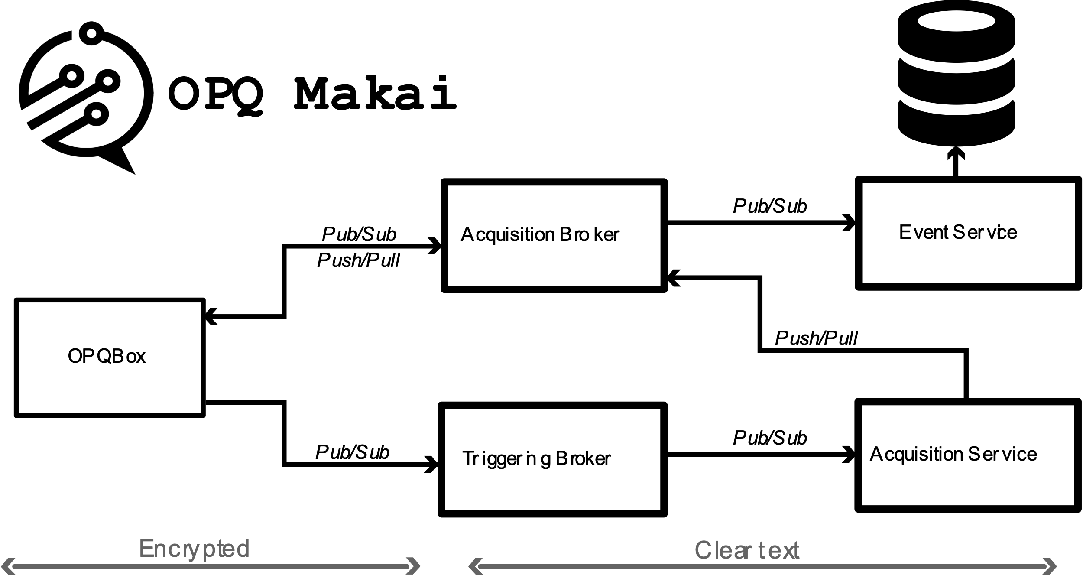
OPQ: Makai/napali

Slide 14
OPQ: mauka

Slide 15
OPQ: Health

Slide 16
OPQ: view

Slide 17
Design of lokahi
Lokahi is made up of several distributed services
Lokahi Sensors
Time Synch Service
Acquisition Service
Web Service
Analysis Service
Collaboration Service

Slide 18
Lokahi: sensors

Slide 19
Lokahi: time synchronization

Slide 20
LOKAHI: Web

Slide 21
Lokahi: Analysis

Slide 22
Lokahi: collaboration

Slide 23
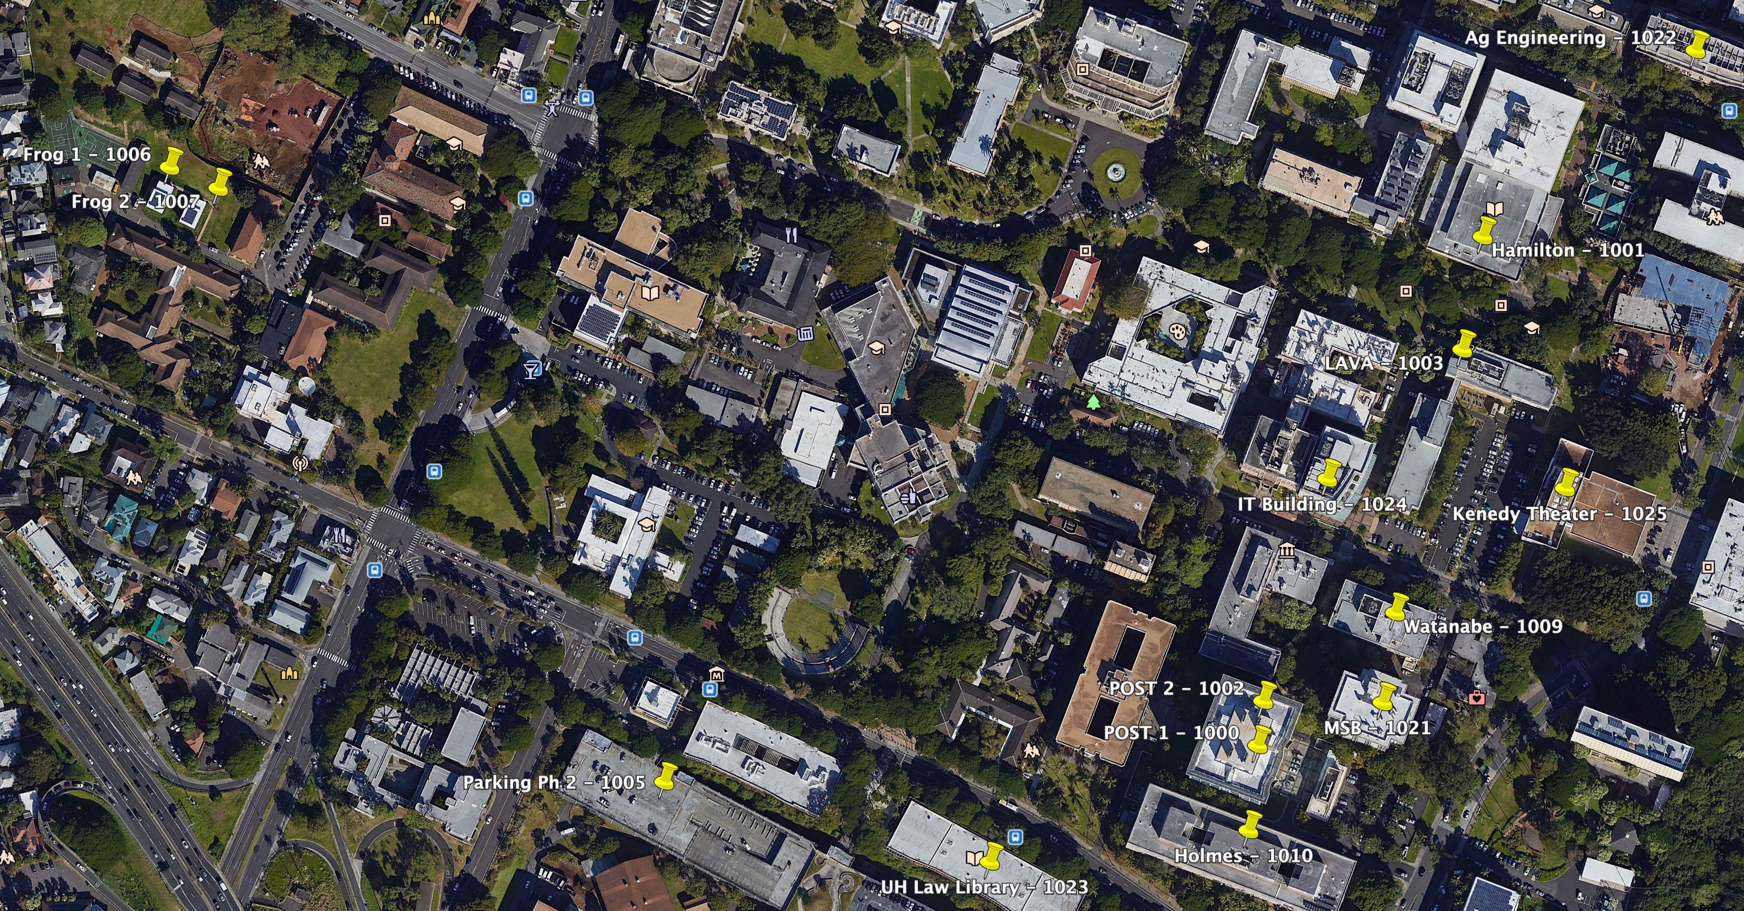
Evaluation: Deployment of laha reference implementations

Slide 24
Evaluation of data validation

Slide 25
Evaluation of generality of laha framework

Slide 26
Evaluation of converting primitive data into actionable insights

Slide 27
Evaluation of big data sensor management

Slide 28
Evaluation of tertiary goals

Slide 29
Results of data validation

Slide 30
Results of generality of laha

Slide 31
Results of converting primitive data into actionable insights

Slide 32
Results of tiered management of big data

Slide 33
Results of tertiary goals

Slide 34
conclusions

Slide 35
Future directions
Machine learning
Modifying windows and thresholds
Additional simulations
Altering the Level-hierarchy
Enhanced metric collection
Expanded sensor coverage

